Slide 1

Hackathon Idea Submission

Slide 2

👨‍👦‍👦 Team name and member details
Team Name: DubsOnly
Member 1: Radha Krishna Garg
Member 2: Md. Anas Jamal
Member 3: Aryan Gupta
Member 4: Chirag Gupta
📝 Theme Name: ChatGPT powered assistance

Slide 3
🚩 Problem statement
The exact problem we intend to solve is the difficulty employees face in accessing and retrieving relevant information from an organization's internal private data. Often, internal data is spread across multiple sources, making it difficult to find and access the information needed to make informed decisions. Additionally, employees may not have the technical expertise to navigate complex data structures or may not be familiar with the terminology used in the data.

Slide 4
💡 Solution
To solve the problem of difficulty in accessing and retrieving relevant information from an organization's internal private data, we have developed Dexi, a chatbot powered by Chat GPT technology. Dexi provides a user-friendly interface that enables employees to access internal data through natural language queries. This improves accessibility and usability of internal data, leading to increased efficiency, productivity, and better decision-making.
The impact metrics that one can use to analyze the effect of the solution include the number of successful queries handled by Dexi, the speed at which information is retrieved, and the level of user satisfaction with the chatbot's performance.
The technology stacks used in Dexi include Arduino and other IoT components for hardware integration, Chat GPT for natural language processing, and Telegram for remote control of connected home appliances. We have assumed that the internal databases or sources are compatible with the technology used in Dexi and
that adequate security measures have been taken to protect the organization's internal data.

Slide 5
💡 Solution
Our decision to use Chat GPT for natural language processing was based on its ability to handle complex queries and provide relevant answers. We also chose Arduino and IoT components for hardware integration as they are widely available and easily accessible.
The solution can be easily implemented and can be effective in improving the accessibility and usability of internal data. The extent of scalability and usability will depend on the organization's specific needs and requirements.
Overall, Dexi provides a solution that can improve the accessibility and usability of internal data, leading to increased efficiency, productivity, and better decision-making for an organization.

Slide 6
📊 Methodology / Architecture diagram
Flow Chart :
https://github.com/sinisterdaddy/Broadridge/blob/main/flowchart/Flowchart.png
Prototype (Screenshot, Screencast, Image, Video, etc.) :
https://github.com/sinisterdaddy/Broadridge/tree/main/images%20and%20videos
For more please visit : https://github.com/sinisterdaddy/Broadridge

Slide 7
Statistics:
According to a report by Grand View Research, the global smart home market size is expected to reach $184.2 billion by 2028, indicating a significant demand for home automation solutions like Dexi.
A study by Accenture found that 79% of businesses believe that AI will help them gain a competitive advantage in their industry.
The same study also found that AI-powered solutions can increase business productivity by up to 40%.
A survey by Salesforce found that 64% of consumers expect personalized experiences from companies, and AI-powered chatbots like Dexi can deliver such experiences at scale.
A study by Juniper Research found that chatbots could help businesses save over $8 billion per year by 2022, primarily through reduced labor costs.
A report by Gartner predicts that by 2022, 70% of customer interactions will involve emerging technologies such as chatbots, machine learning, and mobile messaging.
Overall, these statistics suggest that adopting a chatbot like Dexi can help businesses stay
competitive, increase productivity, save costs, and meet customer expectations for
personalized experiences.

Slide 8
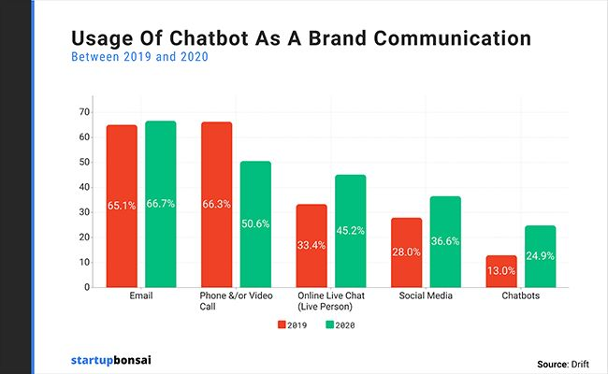
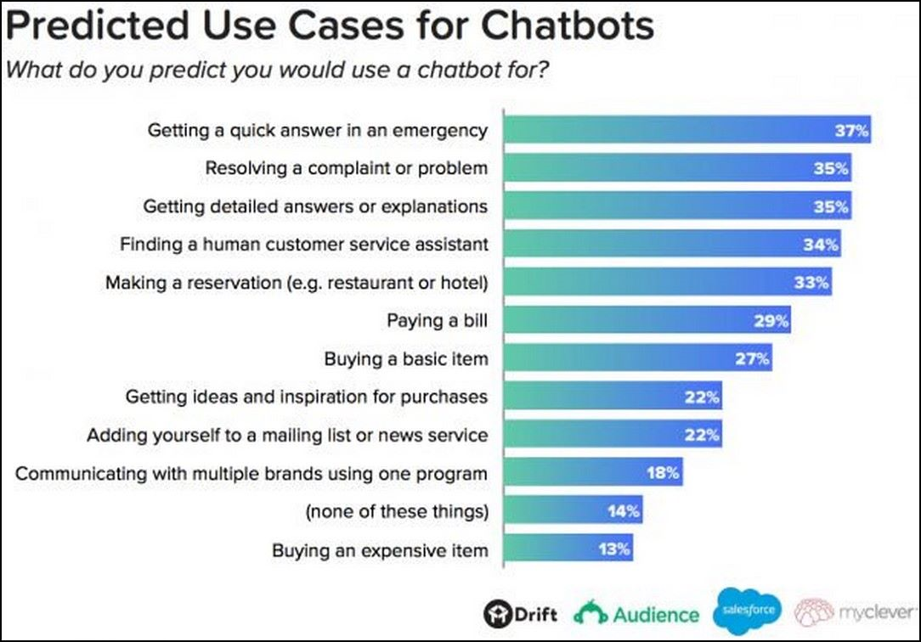
Statistics:

Slide 9
🚀 Future Scope
Business relevance:
Dexi's ability to control home devices through voice automation and chatbot interface provides a significant business relevance. As smart homes continue to gain popularity, Dexi's ability to integrate with various IoT components can make it a valuable asset for home automation service providers.
Optimization:
As the technology for voice recognition and natural language processing continues to improve, Dexi's ability to handle complex queries and provide accurate responses can be further optimized. Additionally, integration with cloud-based data storage and machine learning models can help improve its performance.
Scope for modification:
Dexi's architecture can be modified to include new features and functionalities such as integrating with more home automation devices, adding multi-language support, and enabling compatibility with different chatbot platforms.
Overall, Dexi has a promising future scope in the rapidly growing home automation industry, and with
the right modifications and optimizations, it can become a valuable asset for businesses and households
alike.

Slide 10
🎯 Impact / Novelty
The adoption of the Dexi chatbot solution would have a significant impact on the organization by improving the accessibility and usability of internal private data for employees. This would lead to increased efficiency, productivity, and better decision-making. The solution's ability to handle a wide variety of natural language queries related to the organization's internal data would result in faster and more accurate retrieval of information. Additionally, the chatbot's integration with Chat GPT technology would make it more intelligent and capable of handling complex queries. Overall, the adoption of Dexi would improve the organization's operational efficiency and drive better business outcomes.

Slide 11
Thank You

